Slide 1
TeamOne
Members
- Jay Turakhia
- Shlok Gandhi
- Chirayu Desai

Slide 2
WHY? WHAT? HOW?

Slide 3
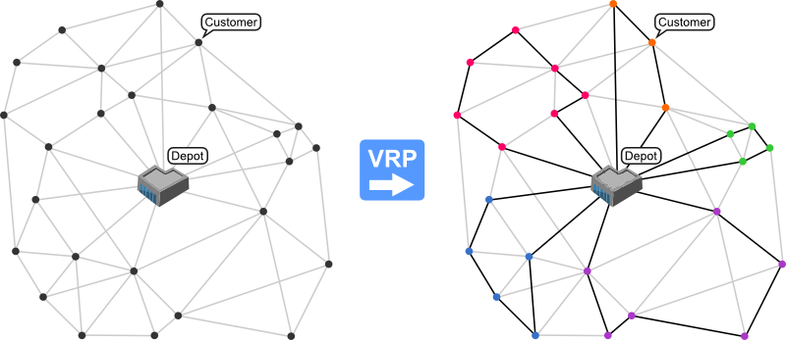
WHAT ?
Vehicle Routing Problem
Proposed by Dantzig and Ramser in 1959
Combinatorial optimization, Integer Linear Programming
Constraints for the problem
Flavors
Capacitated VRP **
VRP with pick up and delivering
Stochastic VRP
VRP with time windows
Image Source - http://neo.lcc.uma.es/vrp/vehicle-routing-problem/
Notes:
“Variables” ( several depots, dispersed cities /customers, vehicle fleet / delivery executives)

Slide 4
WHAT ?
Vehicle Routing Problem
The objective - To deliver a set of customers with known demands on minimum-cost vehicle routes originating and terminating at a depot. ( with necessary restrictions or relaxations )
Notes:
“Variables” ( several depots, dispersed cities /customers, vehicle fleet / delivery executives)

Slide 5
HOW?
But how would I know how good is my solution ?
Exact Approach
TSP
Branch and Bound
Heuristics
Savings: Clark and Wright
Extension: Holmes and Parker
Meta Heuristics
Genetic Algorithm
Constraint Satisfaction Problem

Slide 6

WHY ?

Slide 7


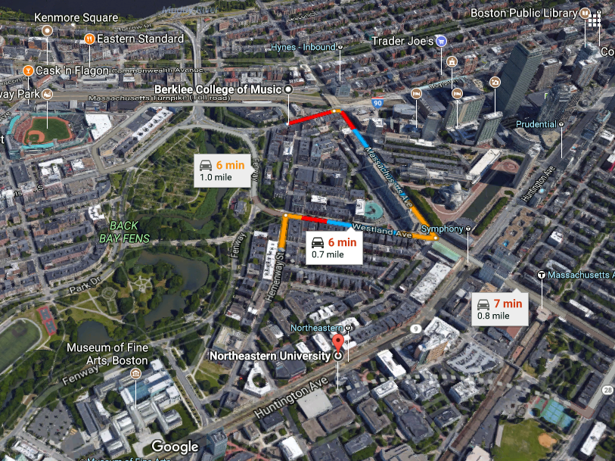



Slide 8

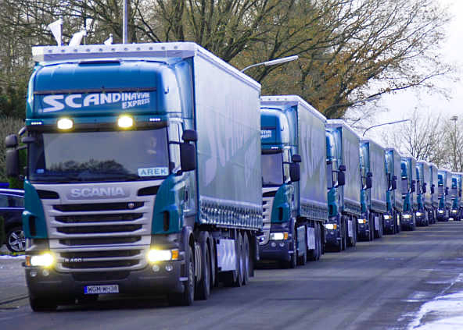
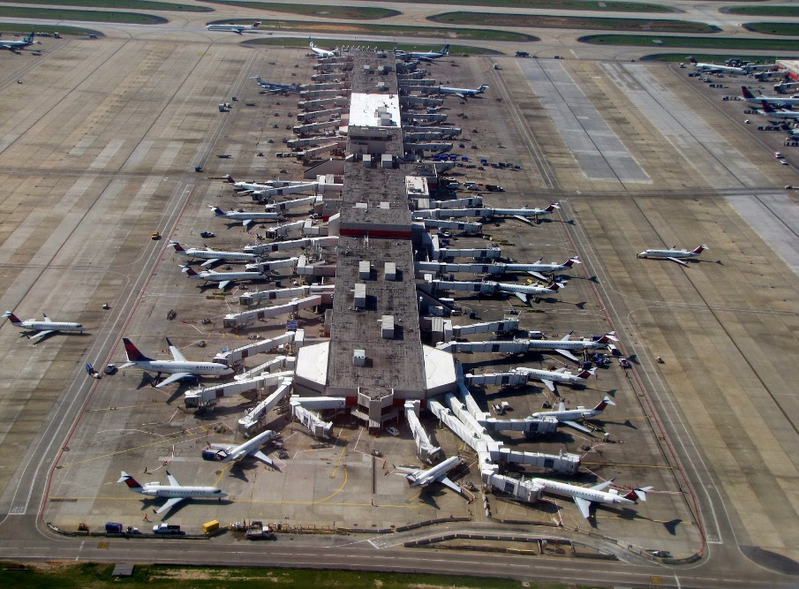

Slide 9
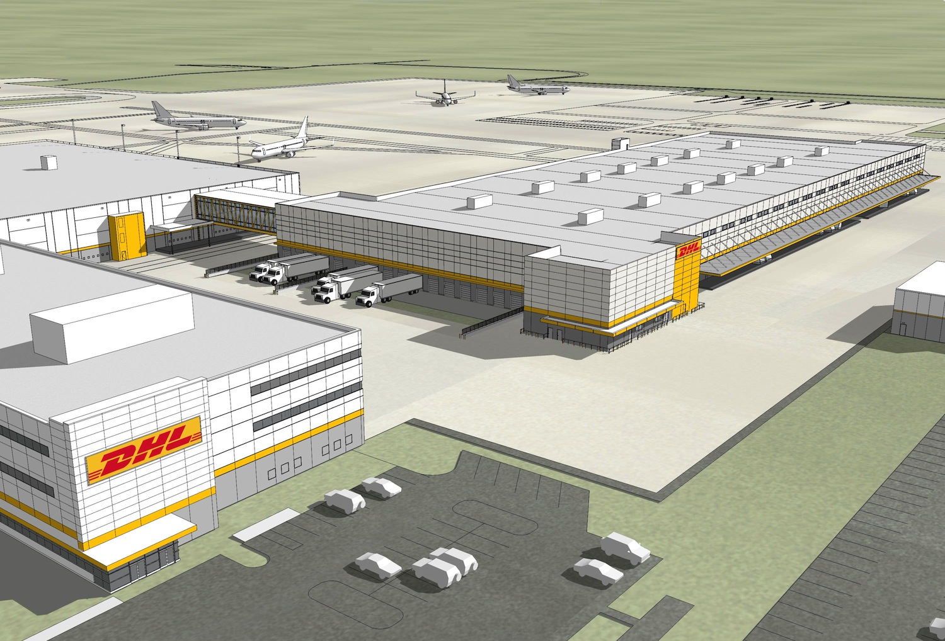


Slide 10
PROPOSED PLAN OF ACTION
Jay – Designing the heuristic function
Shlok – Modifying the Genetic Algorithm so that it suits our case
Chirayu – Work on constraints and the optimized values required for the problem

Slide 11
References
http://www.orcomplete.com/computer/sertalpbilal/solving-vehicle-routing-problem
http://neo.lcc.uma.es/vrp/vehicle-routing-problem/
http://www.jstor.org/stable/2627477?origin=JSTOR-pdf
G. Clarke and J. Wright “Scheduling of vehicles from a central depot to a number of delivery points”, Operations Research, 12 #4, 568-581, 1964.
Holmes RA & Parker RG, 1976, A vehicle scheduling procedure based upon savings and a solution perturbation scheme, Journal of the Operational Research Society, 27(1), pp. 83–92
P. Shaw. “Using Constraint Programming and Local Search Methods to Solve Vehicle Routing Problems”, Proceedings of the Fourth International Conference on Principles and Practice of Constraint Programming (CP ’98), M. Maher and J.-F. Puget (eds.), Springer-Verlag, 417-431. 1998
Alba, E., Dorronsoro, B. “Solving the Vehicle Routing Problem by Using Cellular Genetic Algorithms”, Conference on Evolutionary Computation in Combinatorial Optimization, EvoCOPâ04, LNCS vol. 3004, pp 11-20, Portugal, Springer-Verlag. 2004

